Slide 1
Fossil Fuels as a Resource

Slide 2
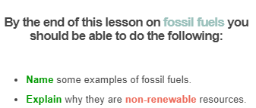


Slide 3


Slide 4
Fossil fuels are made from the remains of dead plants and animals. We use them to get energy and produce the electricity that powers our lives!

Slide 5
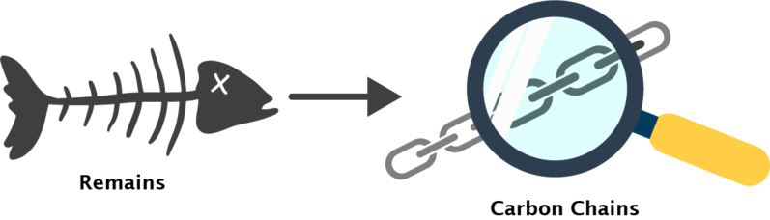
To make fossil fuels, unfortunately some living things have to die.
When animals and plants die in water they are gradually covered by silt and mud over millions and millions of years. Over time their remains are buried and decay.
They are broken down to make carbon chains - the most basic ingredients of living things. They look a bit like metal chains, but are reeeeeeeally tiny!

Slide 6
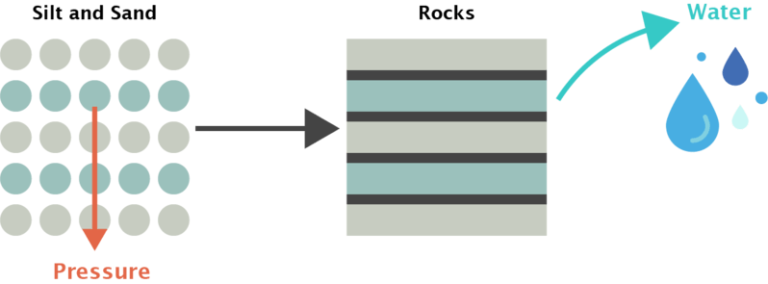
As more silt and sand pile on top, the animals and plants are compacted to make rocks.
Pressure and heat squeeze out any water, so that only carbon chains are left behind in the rocks.

Slide 7
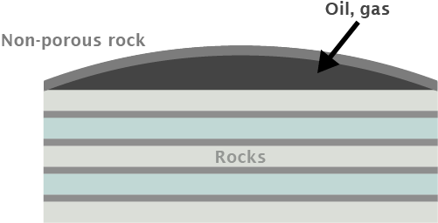
To make oil and natural gas, the carbon chains must be concentrated underground.
This happens when they are trapped under a layer of non-porous rock that stops them rising back to the Earth's surface.
(Non-porous means that there are no holes in the rock for oil to flow through!)

Slide 8

Fossil fuels are a non-renewable energy source.
Throughout this lesson you will learn about the formation of fossil fuels and why they are considered a non-renewable energy source.
Some fossil fuels are oil, coal, gas and their products (petrol and diesel).

Slide 9
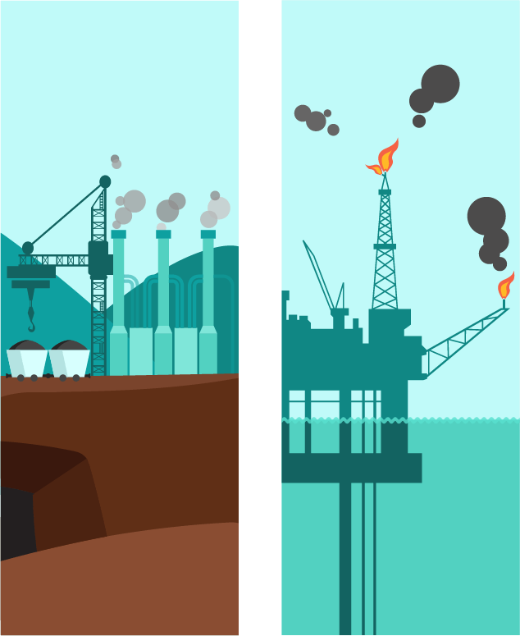
Fossil fuels are used by people to create useful forms of energy.
Fossil fuels are converted to useful forms of energy such as electricity by being burnt.
This releases large amounts of energy but also large amounts of carbon dioxide, which is a greenhouse gas.
The increase in carbon dioxide is thought to contribute to climate change and global warming.

Slide 10

The most important fossil fuel in the world is coal.
It is burned in power stations to produce the electricity that powers your home, computer and cellphone.
Coal mined in Australia provides 69% of its electricity, so it's a very important resource!

Slide 11
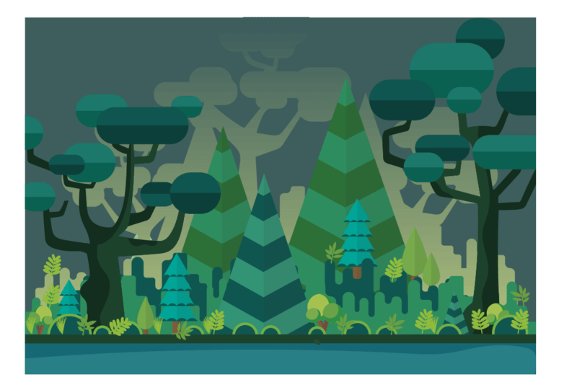
Coal is different to oil and natural gas.
While oil and gas form in the ocean, coal is formed in swamps.
It is made from the remains of dead plants that are buried and squashed in a swampy environment.

Slide 12

Water usually contains oxygen, but in a swamp the oxygen can run out.
When that happens, trees growing in the swamp die and fall into the water. Those trees are covered by mud and buried. Then, more trees die and pile on top, then more mud, and so on.
This series of events results in repeating layers of mud and plant matter:
The cycle repeats until the first layer of tree material is deep enough to be compacted and form peat.

Slide 13
Over time, more mud and plant matter pile on top of the peat. They squash it down and squeeze all the water out of it.
If there is enough pressure, all the water is removed and the peat turns into solid coal.
10 metres of peat can be squashed into just 1 metre of coal - that's how much water is in the peat!

Slide 14
